Slide 1

Azure Banking Data Platform Modernization
End-to-End Architecture: Ingestion, Modeling, Analytics & Real-Time Fraud Detection
Mayur S Karkera

Slide 2

Business Objectives & Outcomes
Unified Data View
Real-Time Fraud Mitigation
Consolidated ATM, UPI, and Mobile Banking data into a Single Source of Truth (SSOT), eliminating fragmented data silos across systems.
Instant scoring and alerting using Event Grid and Cosmos DB, catching fraud as it happens—not days later.
Customer 360
Regulatory & Security
Comprehensive insights into customer behavior and risk profiles for personalized banking experiences.
RBI-compliant reporting within a Zero-Trust Network architecture using Azure Firewall for enhanced security.

Slide 3

High-Level Architecture: Lambda Design
Batch Layer (Cold Path)
Real-Time Layer (Hot Path)
Core Banking System flows through ADLS Gen2 with Bronze, Silver, and Gold zones, culminating in Azure SQL Data Warehouse for historical analysis.
ATM and UPI events stream through Event Grid to Azure Functions, landing in Cosmos DB for instant fraud detection and response.
Both layers converge at the Serving Layer with Power BI dashboards and API endpoints, all protected by VNETs, Private Endpoints, and comprehensive firewall governance.

Slide 4
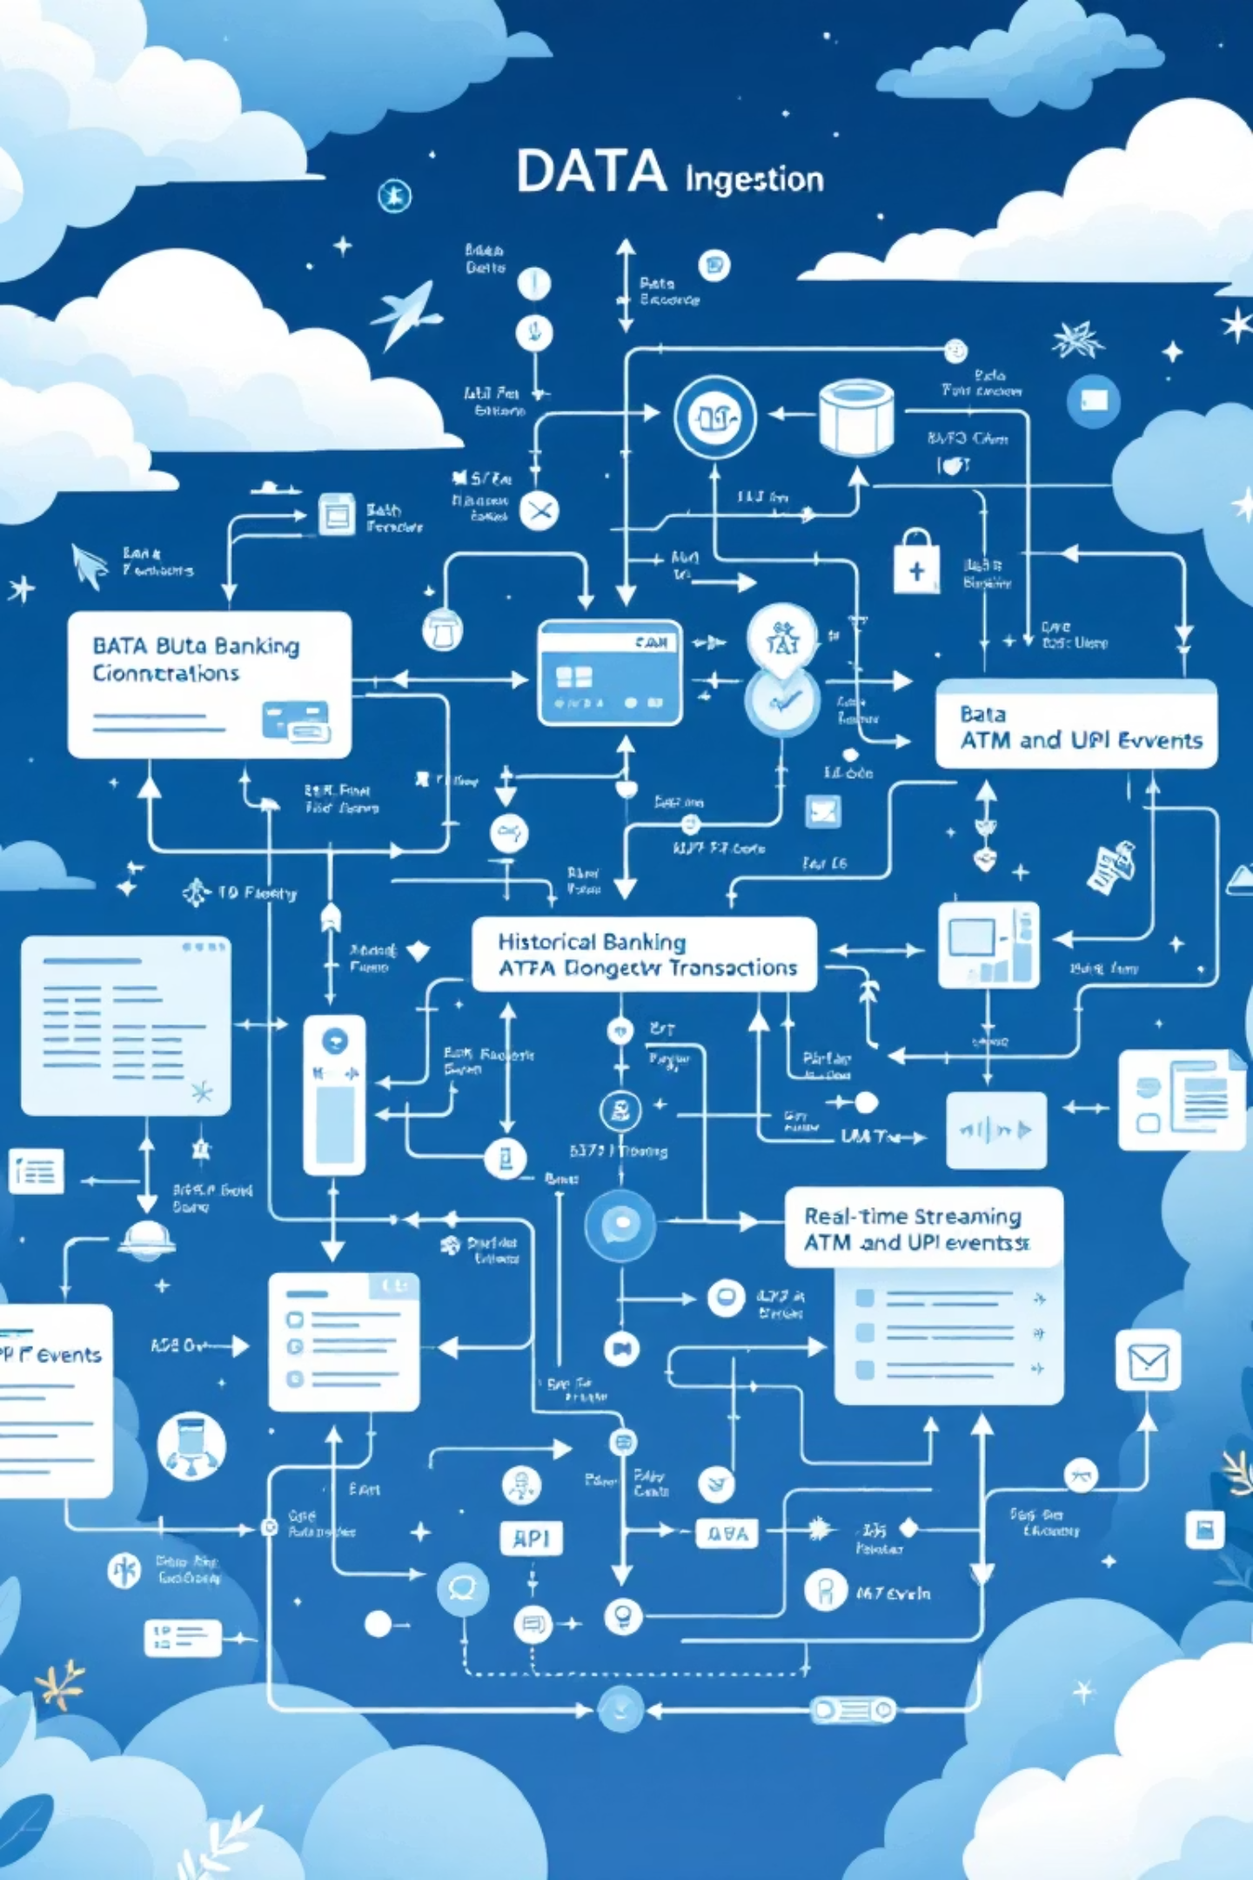
Data Ingestion Layer
Batch Ingestion
Daily CSV and Parquet dumps from Core Banking systems
1
Lands in ADLS Gen2 Bronze Container
Validated by Azure Functions before processing
Handles terabytes of historical transaction data
Streaming Ingestion
ATM and UPI transaction events captured in milliseconds
2
Azure Event Grid push-push model ensures low latency
Queue Storage buffers for reliable processing
Direct write to Cosmos DB via queue-triggered Functions

Slide 5

Transformation Layer: Silver Zone Processing
01
02
Schema Enforcement
Standardization
Reject malformed records and validate data types using Databricks schema validation framework.
Convert all dates to ISO 8601 format and normalize currency values across different banking channels.
03
04
Deduplication
Enrichment
Remove replay attacks and duplicate logs using window functions and unique transaction identifiers.
Join with reference data including Branch IDs, Transaction Types, and merchant category codes.
Apache Spark on Azure Databricks processes millions of records daily, ensuring raw data transforms into high-quality, usable information ready for analytics.

Slide 6





Gold Layer: Star Schema Data Modeling
DimCustomer
FactTransactions
Customer demographics, risk scores, and relationship details.
Central fact table containing metrics: Amount, Fee, Duration, and transaction counts.
DimAccount
Account types, balances, opening dates, and product categories.
DimChannel
Transaction channels: ATM, Mobile, Web, Branch, and UPI.
DimDate
Time intelligence with fiscal periods, holidays, and business days.
This optimized star schema enables blazing-fast analytical queries, allowing business users to slice and dice revenue and usage by any dimension.

Slide 7

Slowly Changing Dimensions: Preserving History
SCD Type 2 Implementation
Key Benefits
Banking data constantly evolves—customers relocate, risk scores update, and account statuses change. We implemented SCD Type 2 for critical dimensions to maintain complete historical accuracy.
Complete audit trail for compliance
Historical trend analysis capability
RowKey: Unique identifier for each version
EffectiveDate: When the record became active
Accurate customer journey tracking
EndDate: When the record was superseded
IsCurrent: Flag for the latest version
Point-in-time reporting accuracy
This approach ensures we never lose customer history, enabling accurate point-in-time reporting and regulatory compliance for audit trails.

Slide 8



Fact Table Loading Strategy
Read Silver Data
Lookup Surrogate Keys
Upsert to Fact
Extract cleaned transactions from Silver layer with validated schemas.
Join with dimension tables to retrieve CustomerSK and AccountSK.
Merge into FactTransactions maintaining referential integrity.
Technical Precision
Performance Optimization
We don't just dump data into our fact tables. Each transaction undergoes careful surrogate key lookups to ensure it's correctly linked to the specific state of the customer and account at the exact moment the transaction occurred.
Using integer surrogate keys instead of business keys dramatically improves query performance. Analytics are optimized on indexed integers, reducing join times by up to 70%.

Slide 9

Real-Time Fraud Detection & Security Architecture
Fraud Detection Engine
Zero Trust Network Security
01
Azure Firewall Protection
Event Grid captures transaction in real-time
All resources behind enterprise-grade firewall with Juniper vSRX integration.
02
Azure Function analyzes geo-velocity patterns
Private Endpoints
03
Traffic between Databricks, SQL, and Storage never leaves Azure backbone.
Detects impossible travel and high-value anomalies
04
Network Isolation
Pushes alert to Service Bus for SMS notification
VNET segmentation ensures complete data protection and compliance.

Slide 10
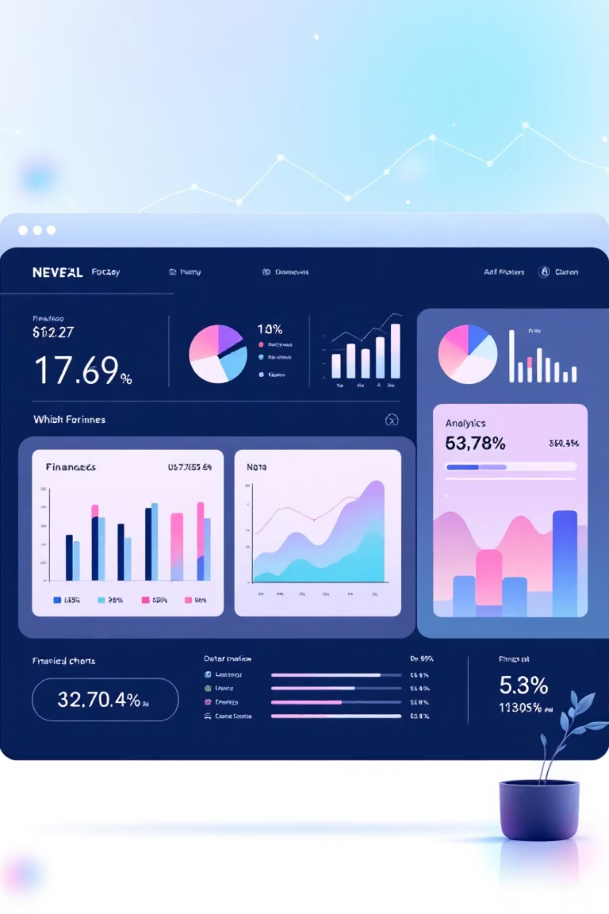
Impact & Operational Excellence
40%
100%
99.9%
Latency Reduction
Real-Time Capability
System Uptime
Reporting time decreased from hours to minutes
Fraud detection now operational in milliseconds
Cloud-native architecture ensures reliability
Power BI Analytics
CI/CD Automation
Interactive dashboards deliver branch performance metrics, fraud trends, and customer insights. Business users access real-time data with intuitive visualizations updated continuously.
GitHub Actions automates deployment of Databricks notebooks and ARM templates. Code moves seamlessly from Dev to Production with automated testing and validation.
Result: A scalable, secure, and future-proof banking platform ready for tomorrow's challenges—delivering both immediate operational value and long-term strategic advantage.

